Slide 1
Distinguishing between different mechanisms of FU-Orionis-type luminosity outbursts
Vardan Elbakyan Eduard Vorobyov
Hauyu Baobab Liu Michihiro Takami
Submitted to A&A

Slide 2
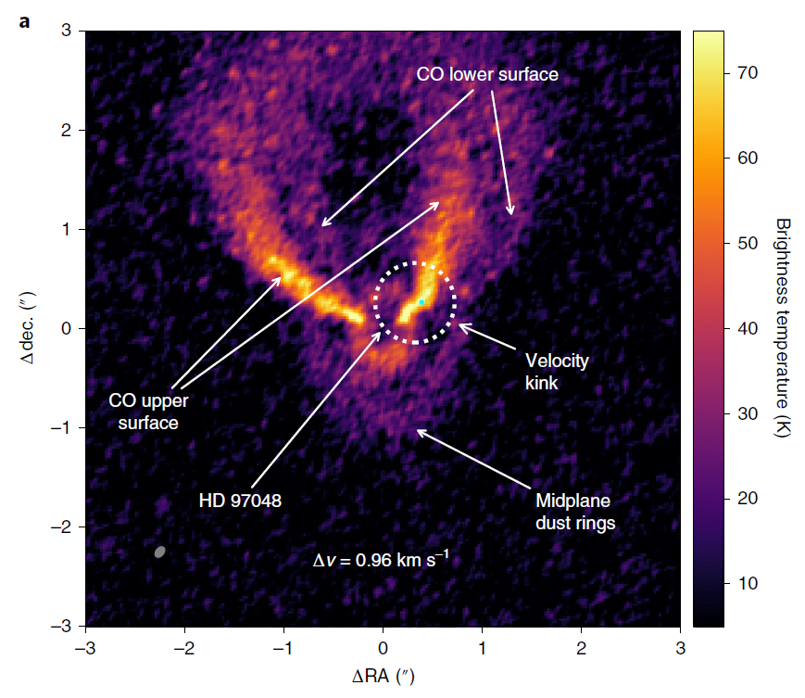
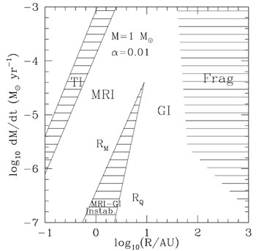
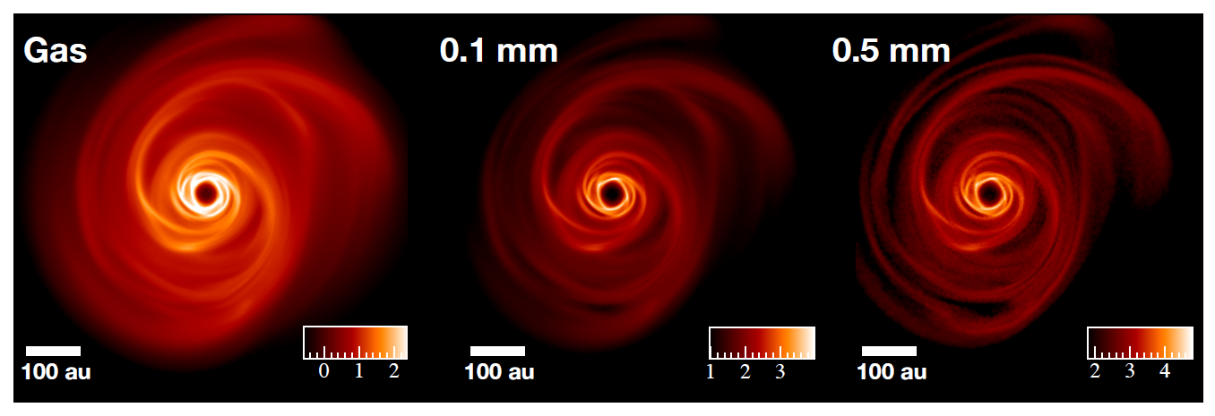
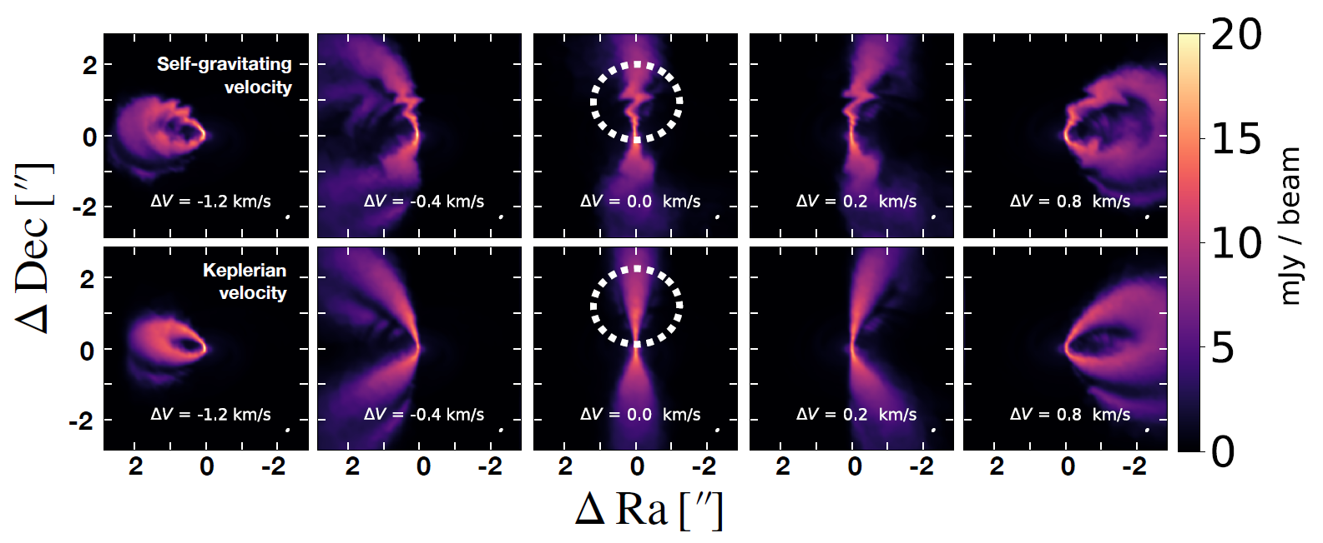
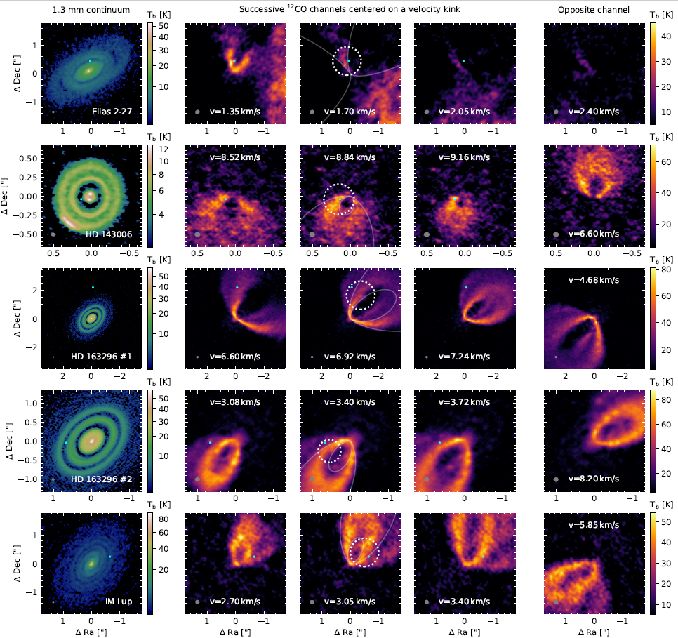
Motivation
Zhu et al. 2009a, 2010b
Pinte et al. 2019
Hall et al. 2020
Pinte et al. 2020

Slide 3
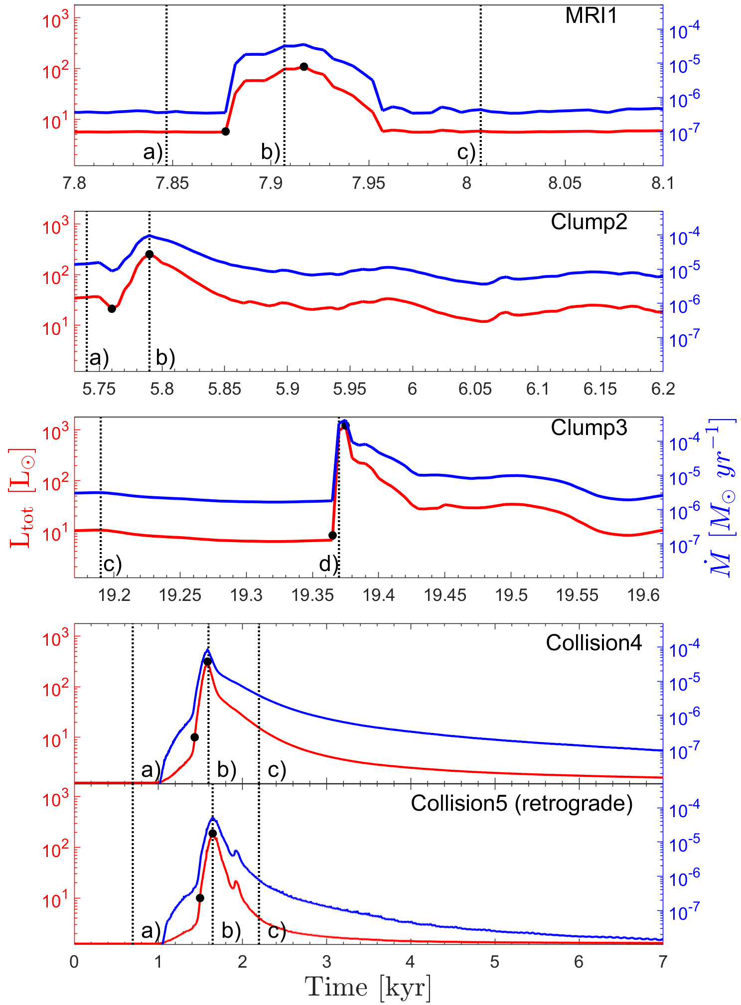
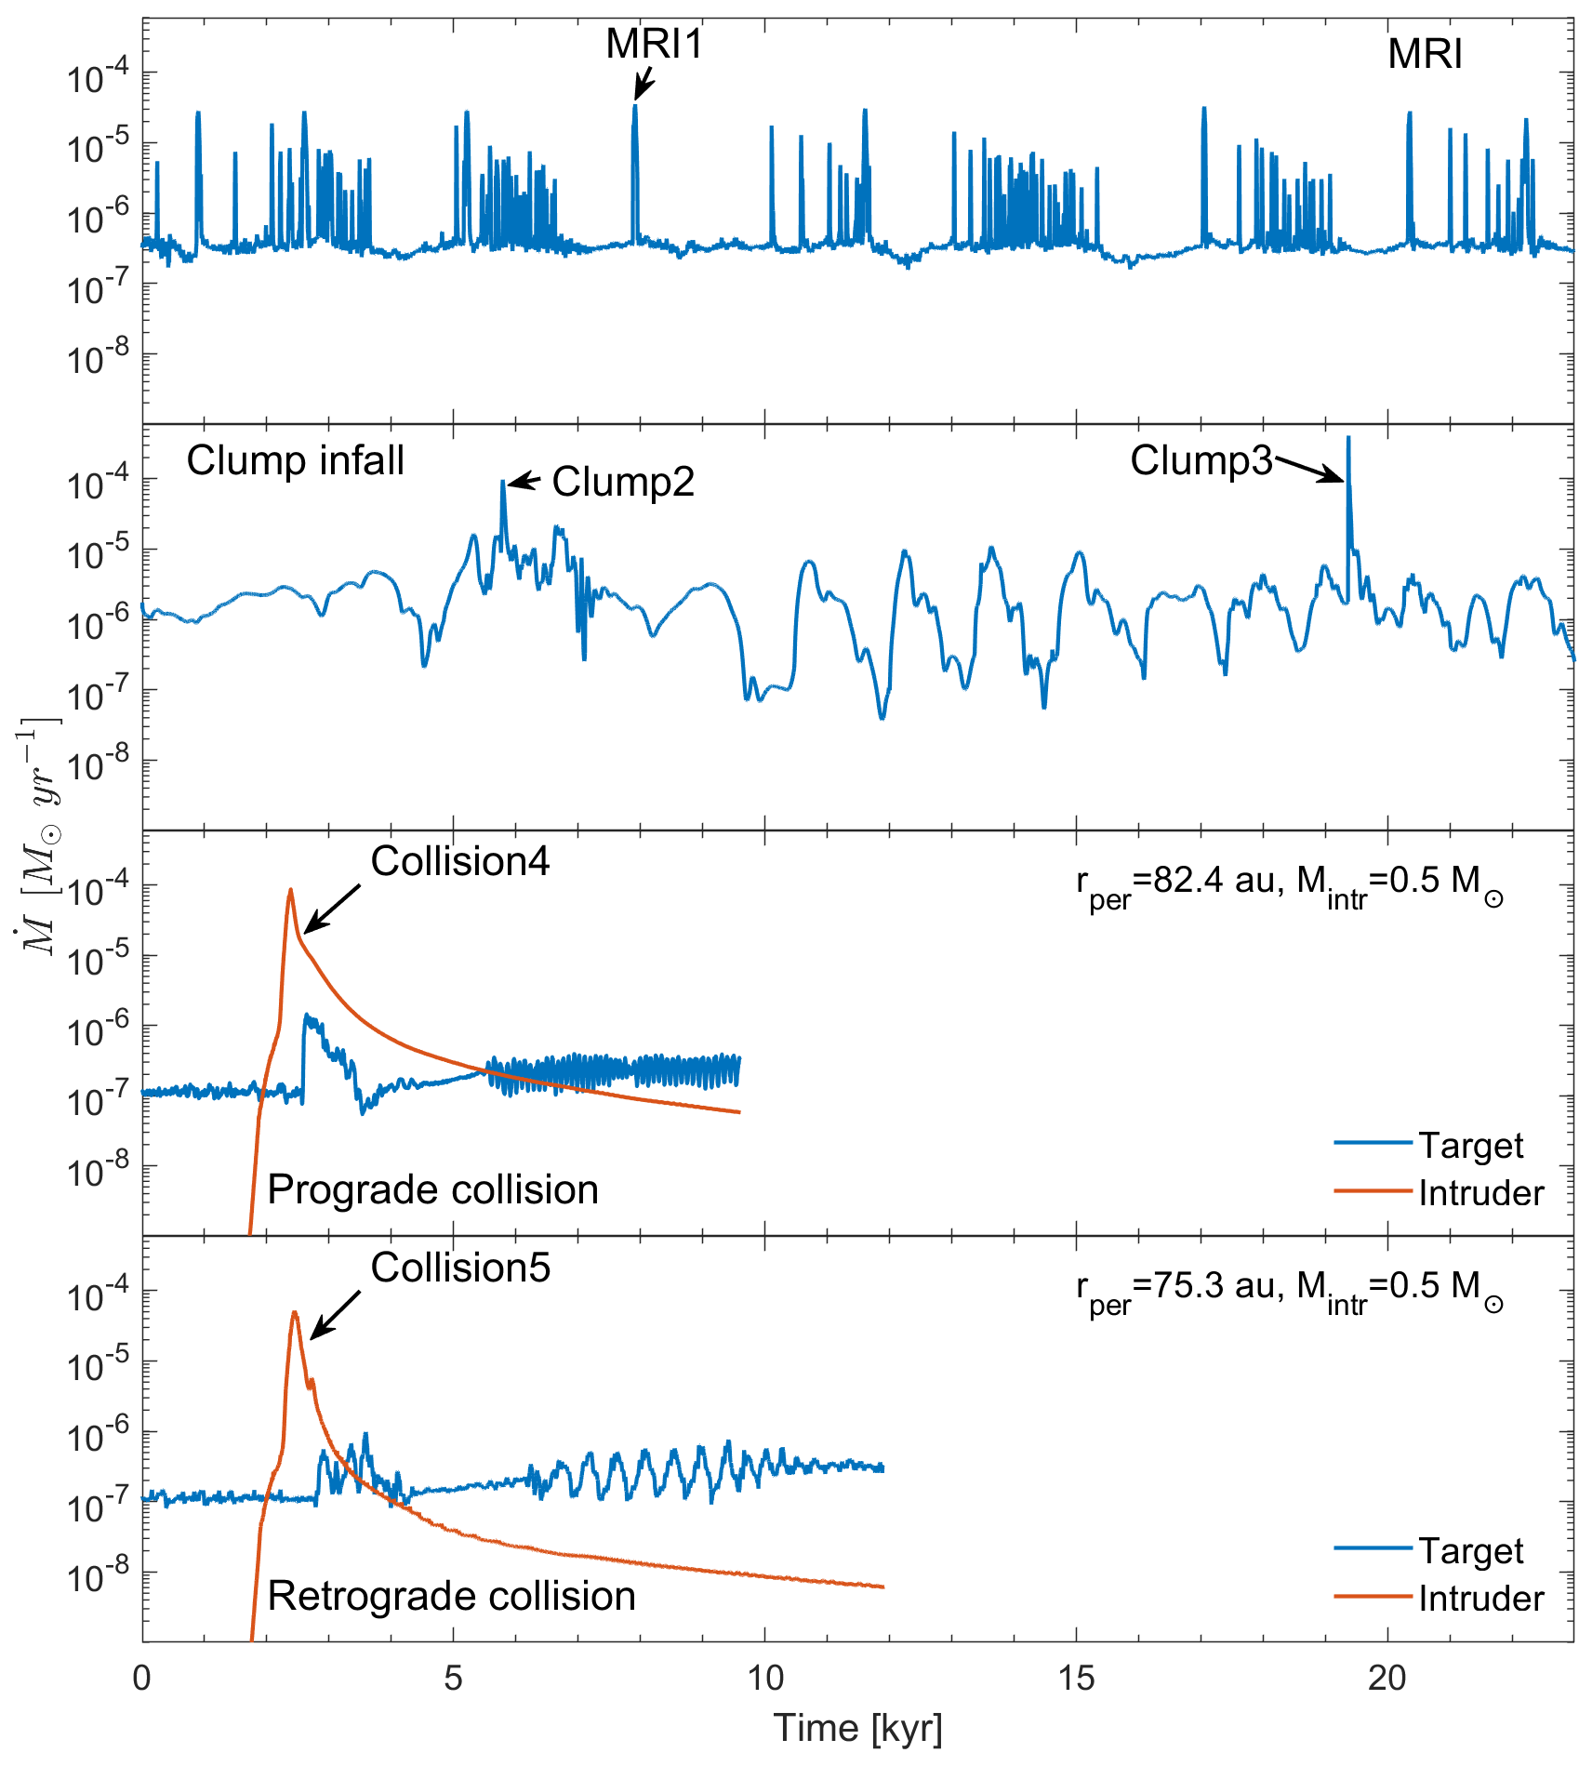
Models
FEOSAD – Formation and Evolution of Stars and Disks
Vorobyov et al. 2018, A&A, 614, 98
Three mechanisms:
the magnetorotational instability (MRI) in the inner disk
clump infall in gravitationally fragmented disks
close encounters with an intruder star
(Hartmann & Kenyon 1996)

Slide 4
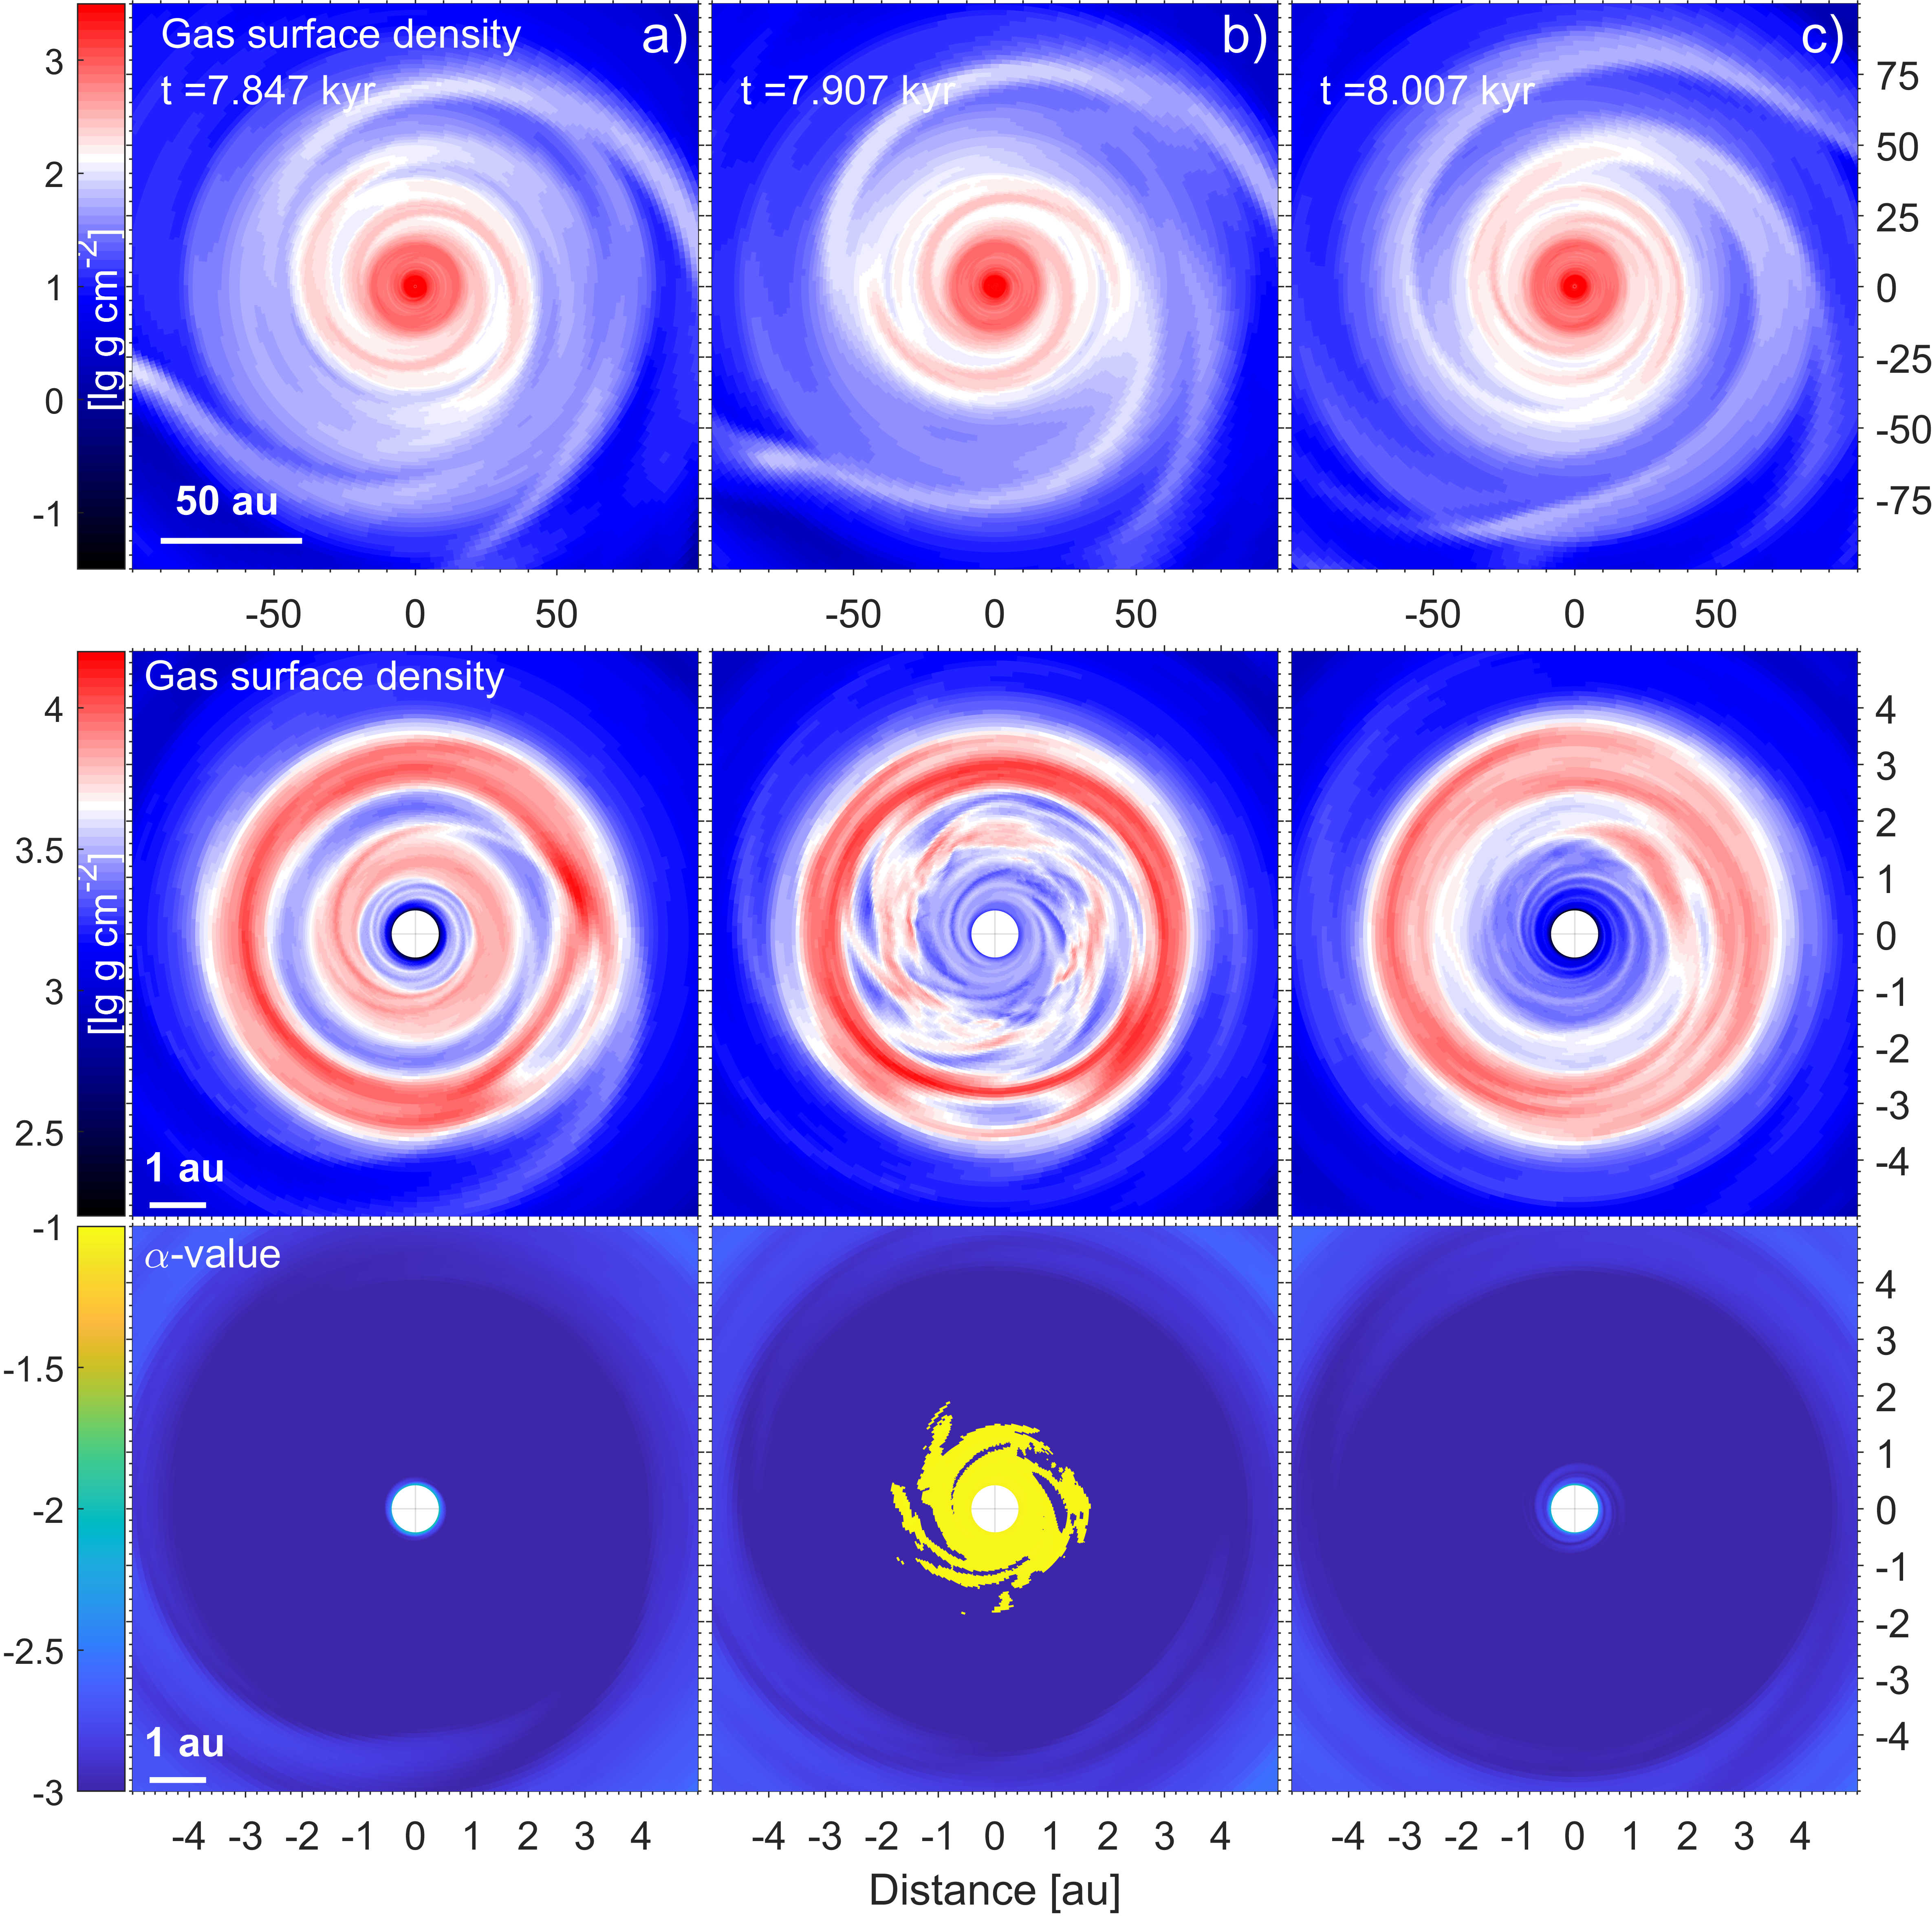
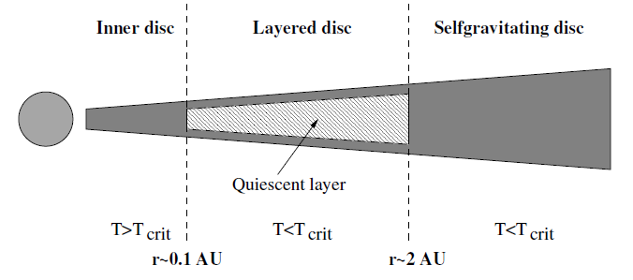
Burst triggered by MRI
Inner MRI active disk
Outer MRI active or
GI-unstable disk
MRI-active layer
MRI
flow of matter
(Dead zone)
Armitage et al., 2001; Zhu et al., 2009b, 2010a
$$α=\frac{Σ_{act}α_{act}+Σ_{dead}α_{dead}}{Σ_{total}}$$
$$α_{dead}=α_{MRI}+α_{resid} \\ α_{MRI}=\left\{\begin{aligned}&a_{act}, if T>T_{crit} \\ &0, otherwise\end{aligned}\right. \\ α_{resid}=10^{−4}−10^{−5} \\ α_{act}≃0.01−1.0 \\ T_{crit}=1100−1500K \\ Σ_{act}=10−100 g \text{c}{\text{m}}^{\text{−2}}$$
$$Σ_{act}−\text{surface} \text{density} \text{of} \text{active} \text{layer}$$
$$Σ_{dead}−\text{surface} \text{density} \text{of} \text{dead} \text{layer}$$
Bae et al., 2014; Kadam et al., 2020

Slide 5
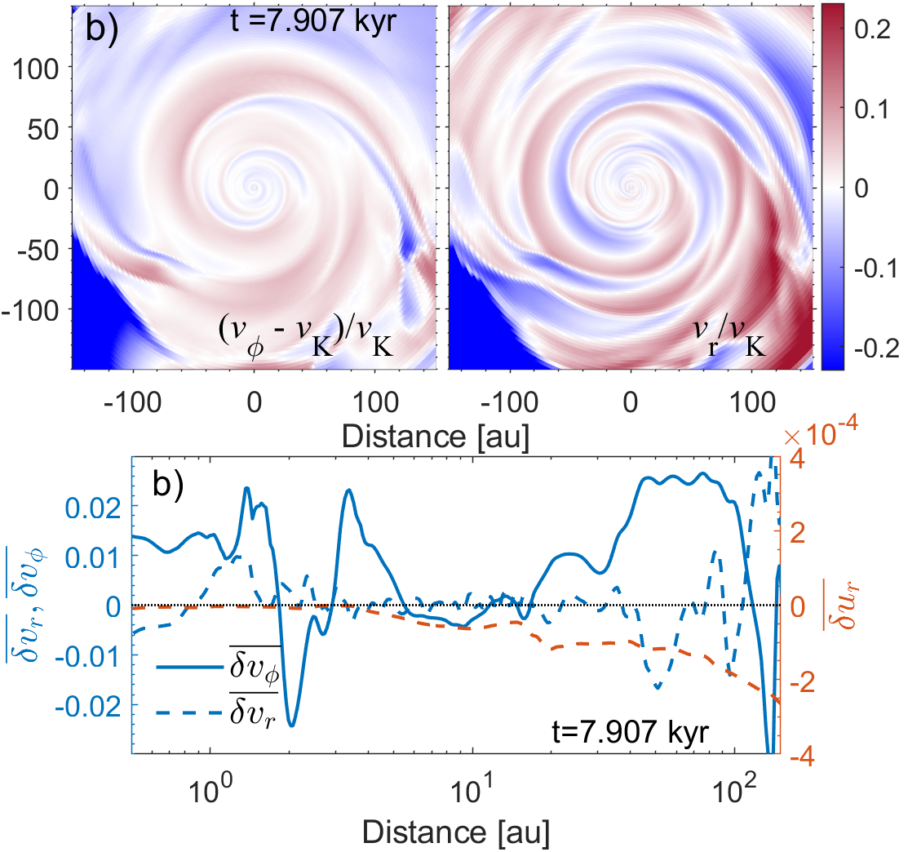
Burst triggered by MRI
Residuals in the rotation maps
δv_{φ} = (v_{φ} – v_{K}) / v_{K}
δv_{r} = v_{r} / v_{K}
weak dynamical
perturbations
during the burst

Slide 6
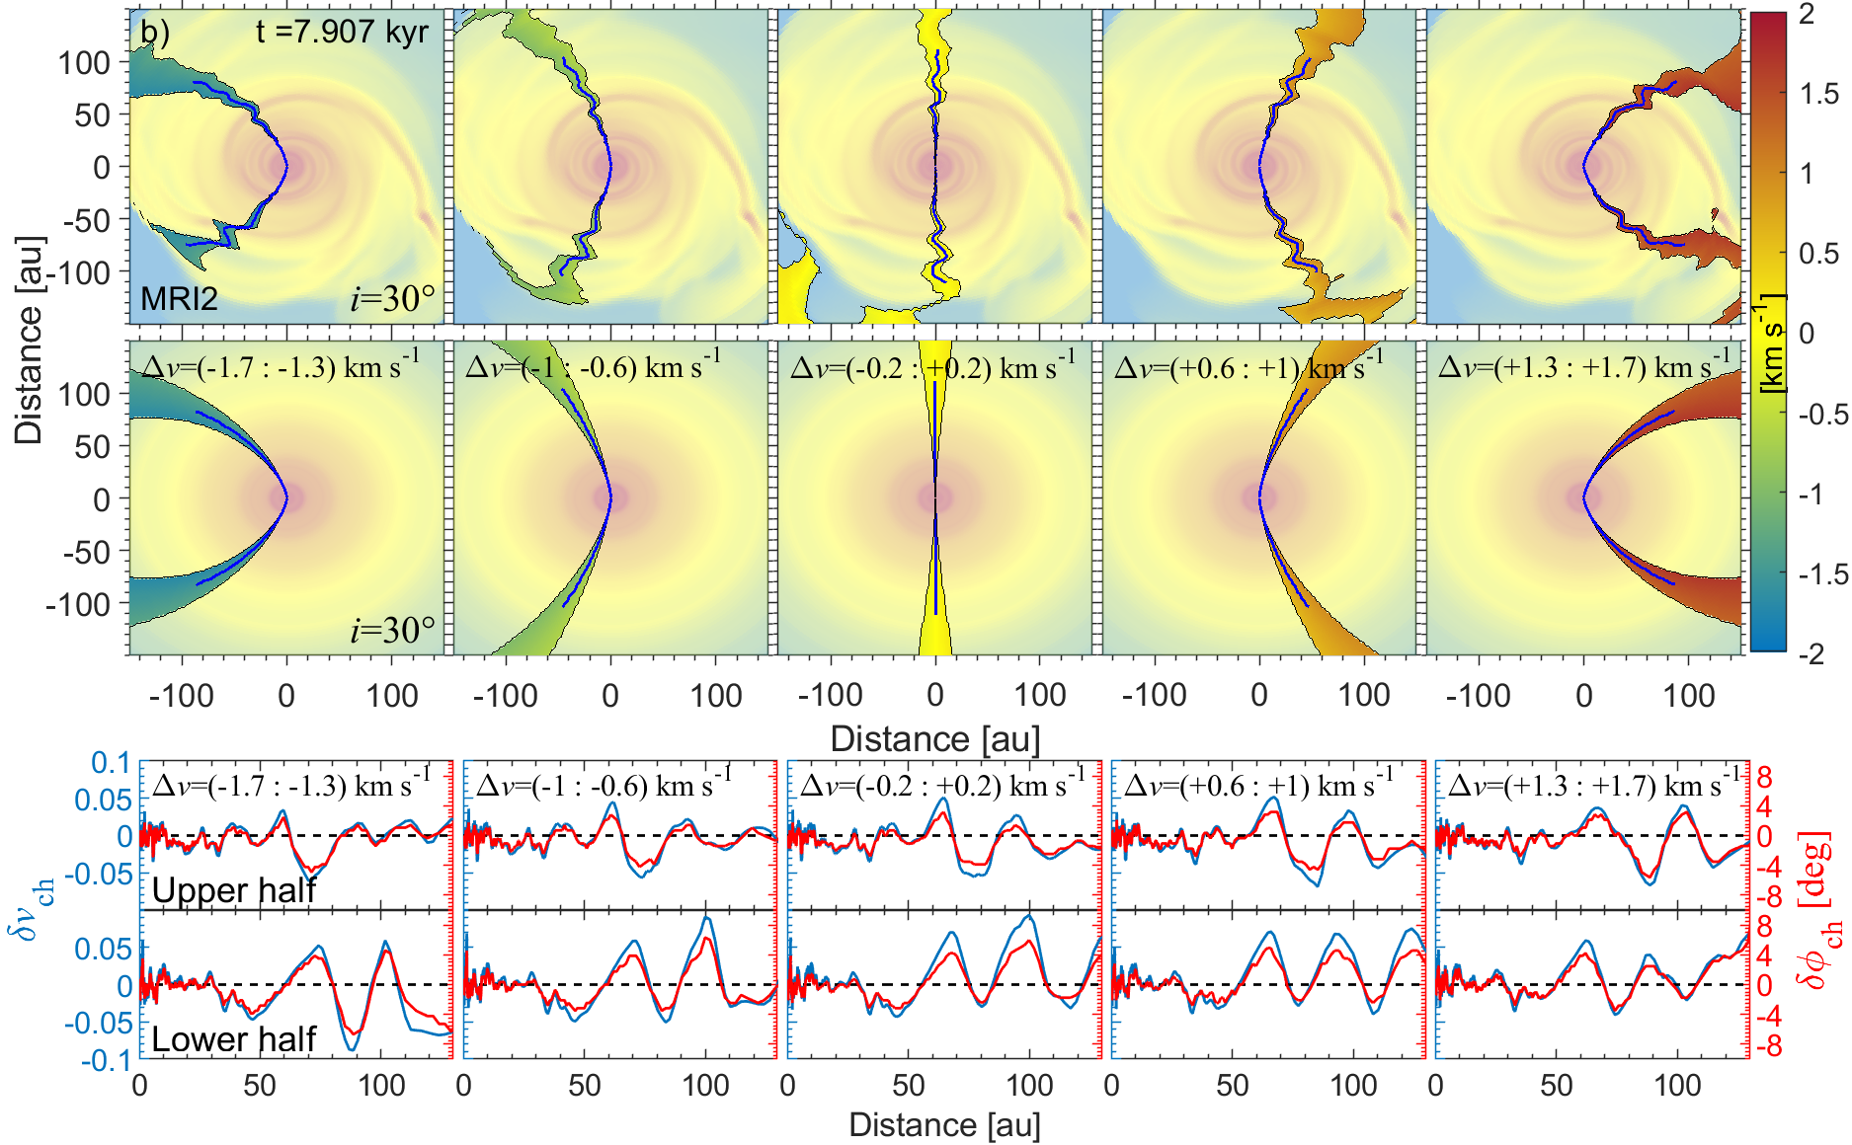
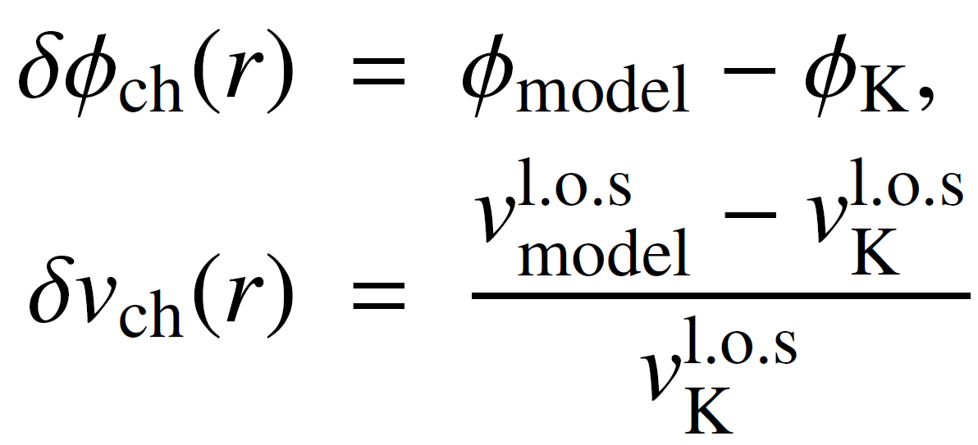
Burst triggered by MRI

Slide 7
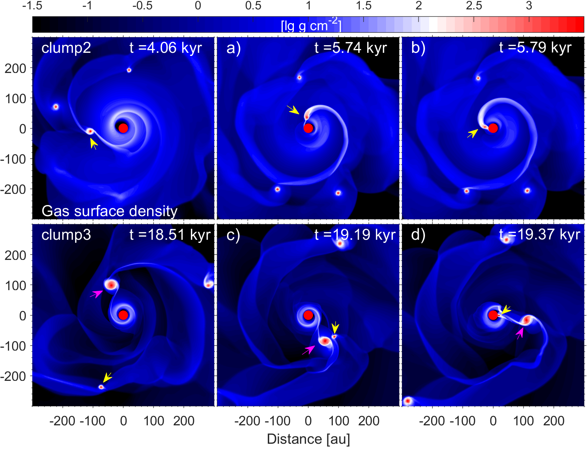
Bursts triggered by clump-infall
Vorobyov & Elbakyan (2018)

Slide 8
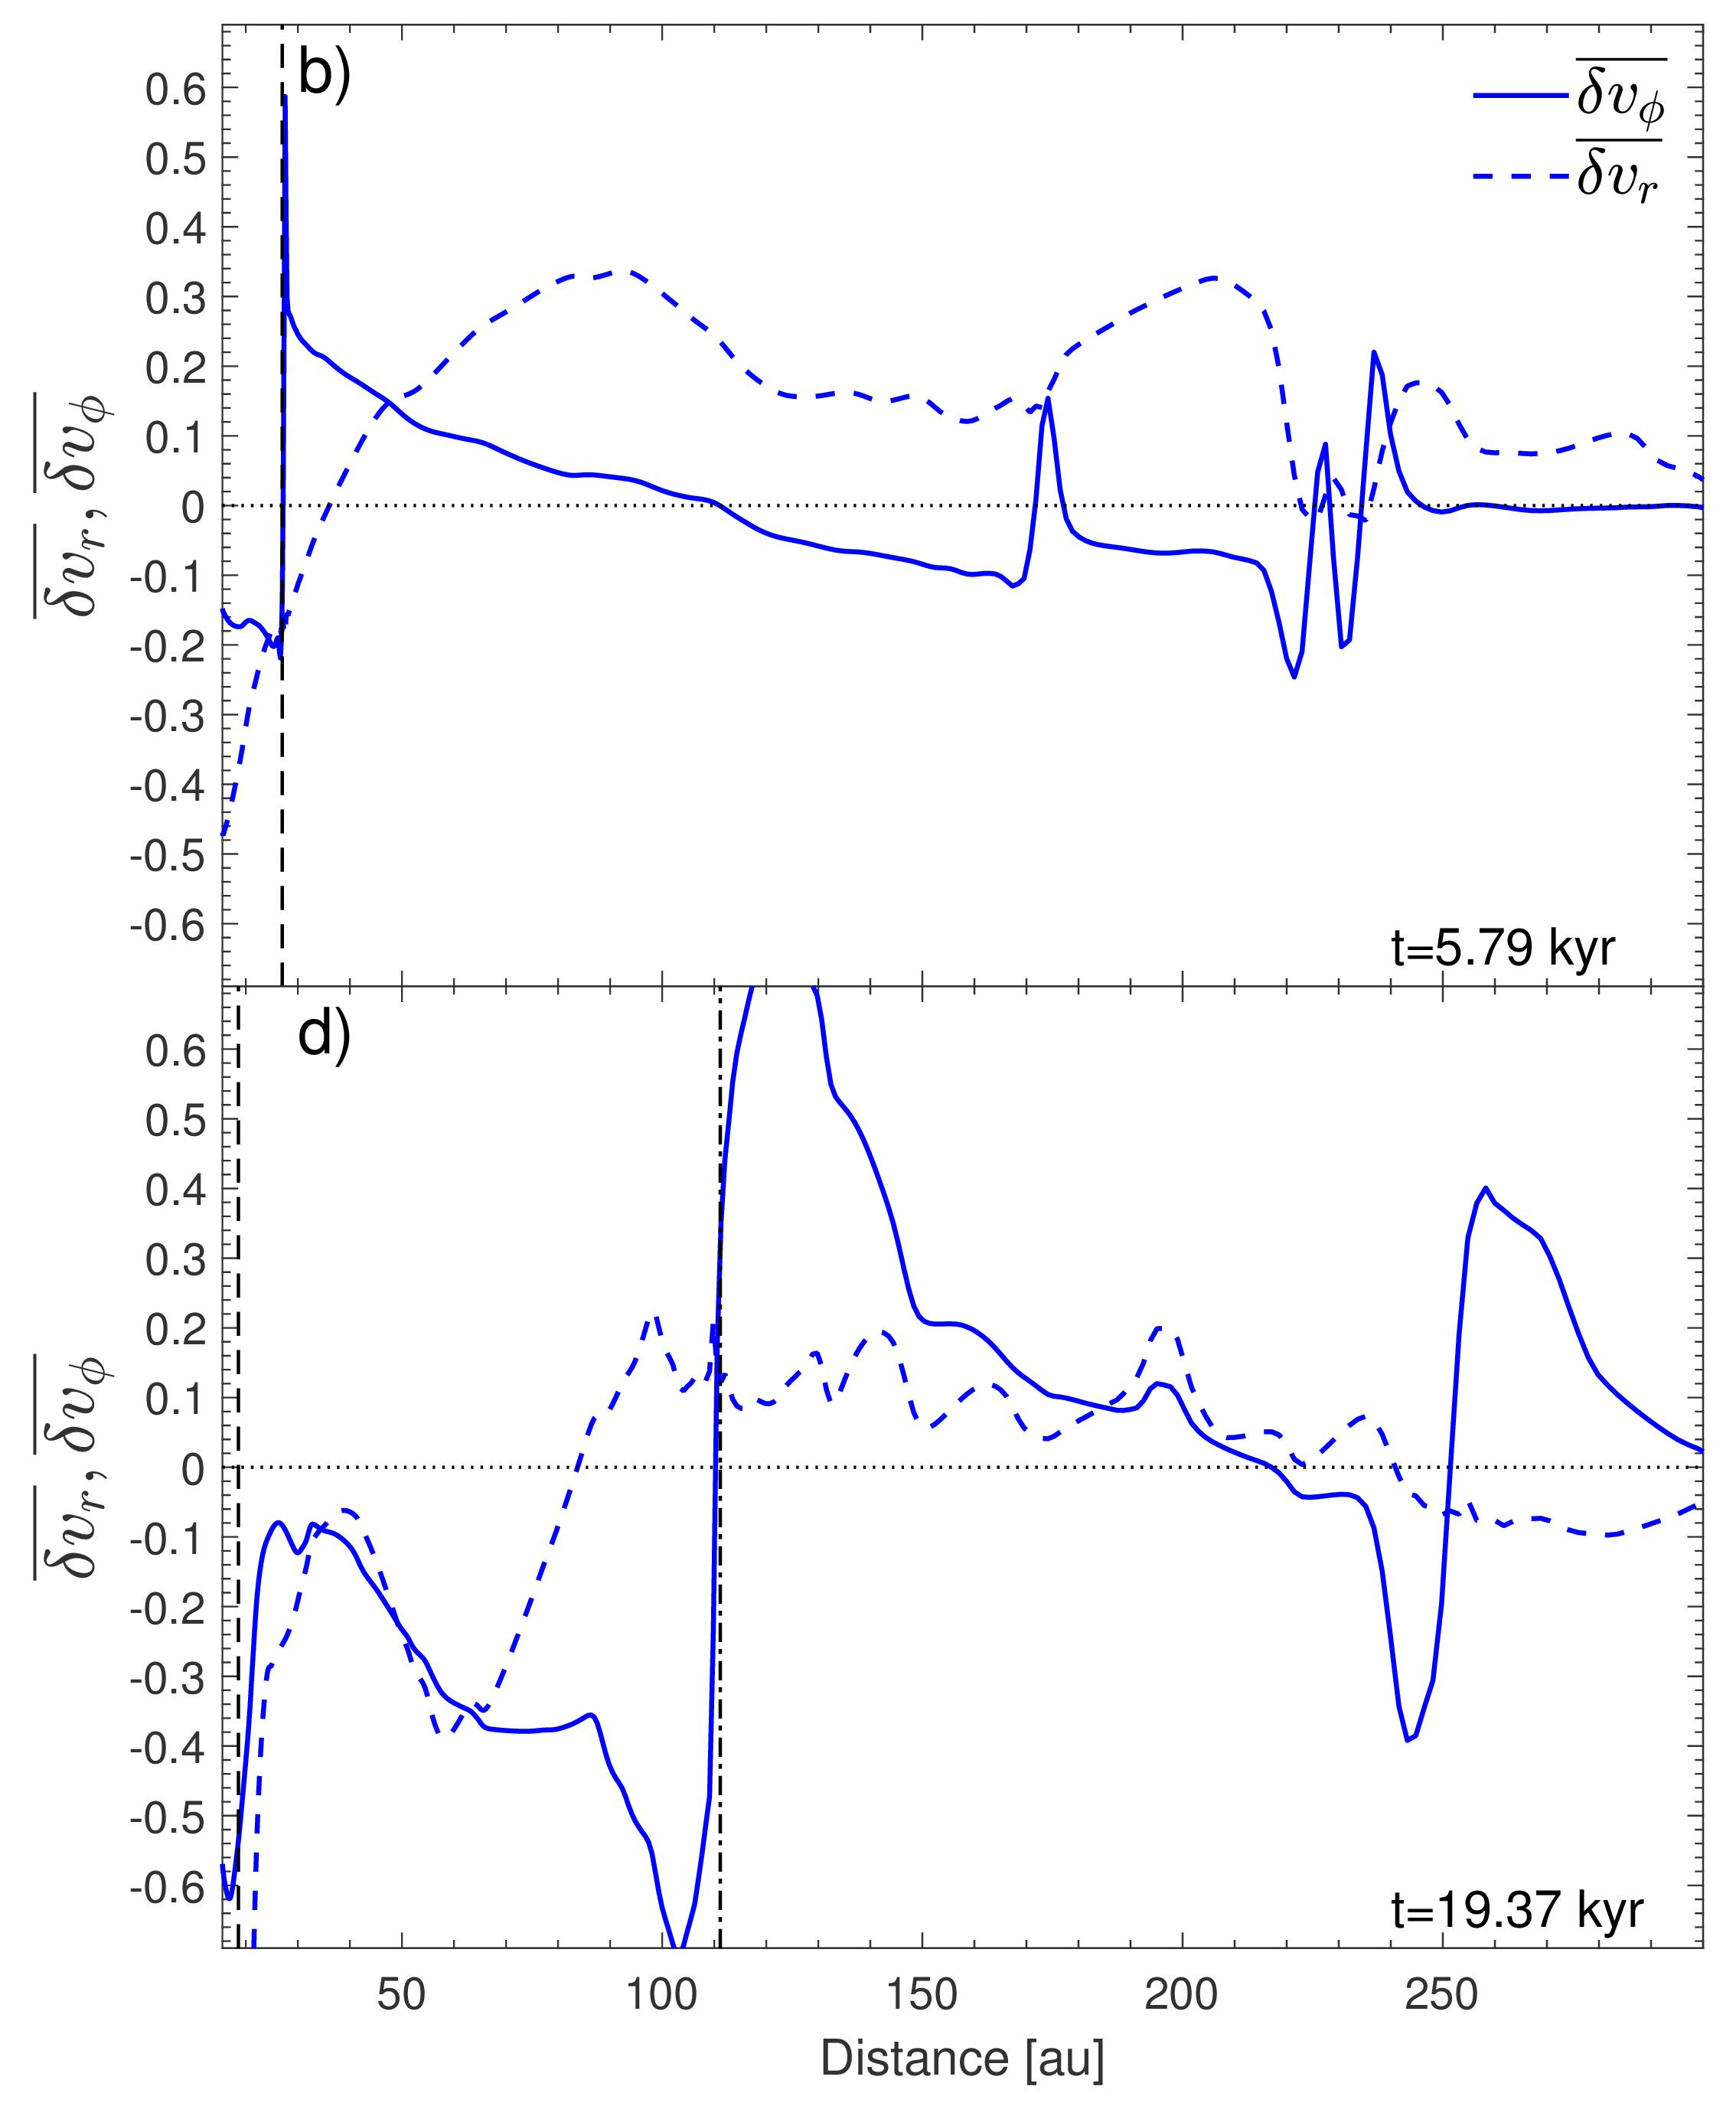
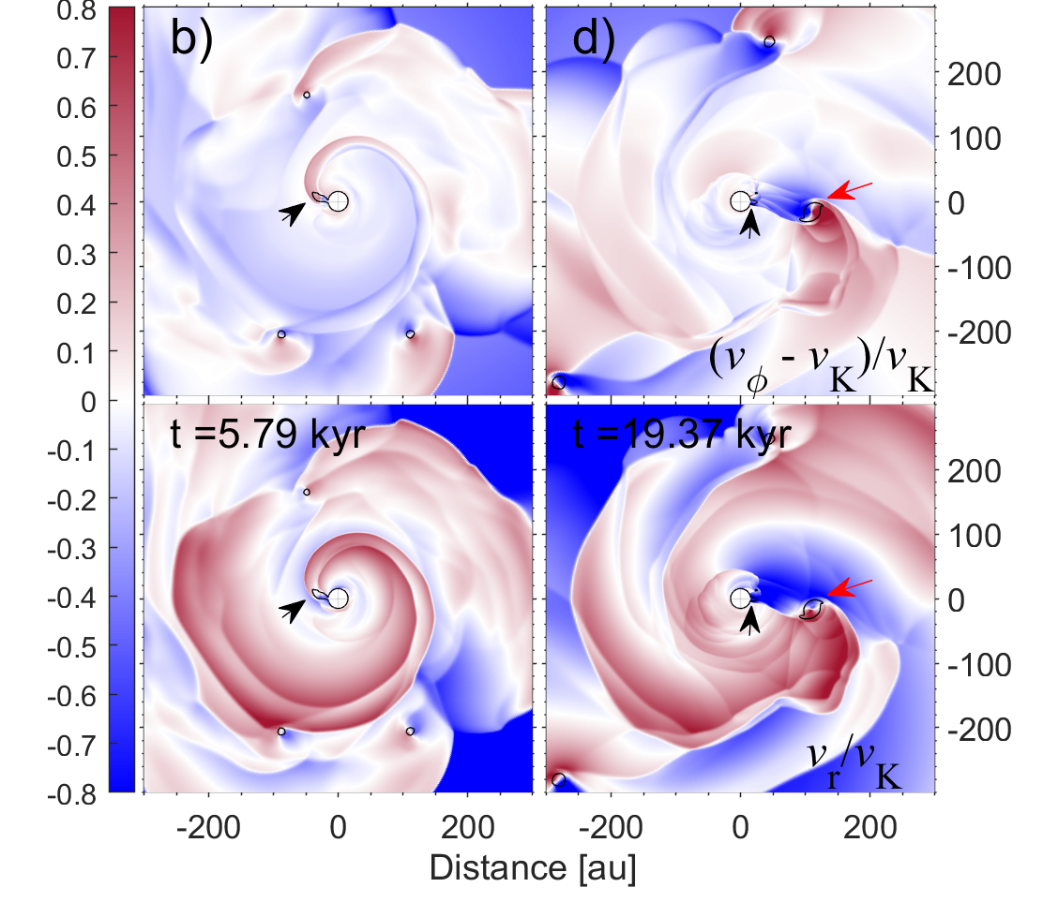
Bursts triggered by clump-infall
δv_{φ} = (v_{φ} – v_{K}) / v_{K}
δv_{r} = v_{r} / v_{K}
Strong dynamical
perturbations
during the burst

Slide 9
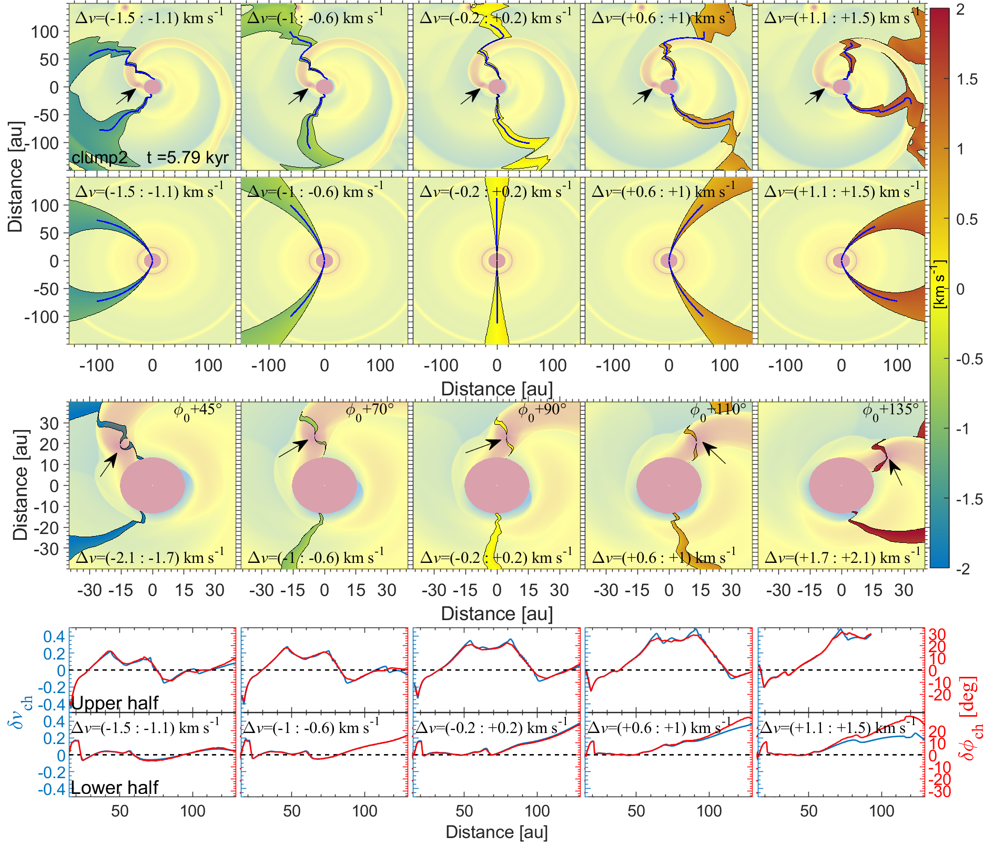
Bursts triggered by clump-infall

Slide 10
Bursts triggered by collisions
M_{intr}=M_{trg}=0.5 M⊙
The intruder creates
tail-like structures
(Aikawa et al. 2019;
Vorobyov et al. 2020)

Slide 11
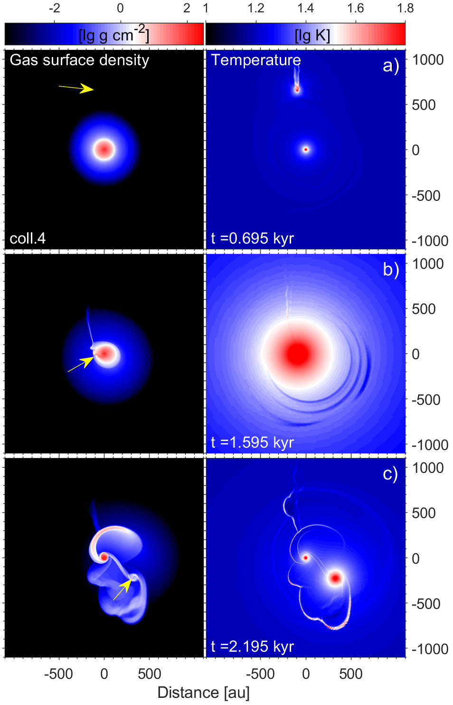
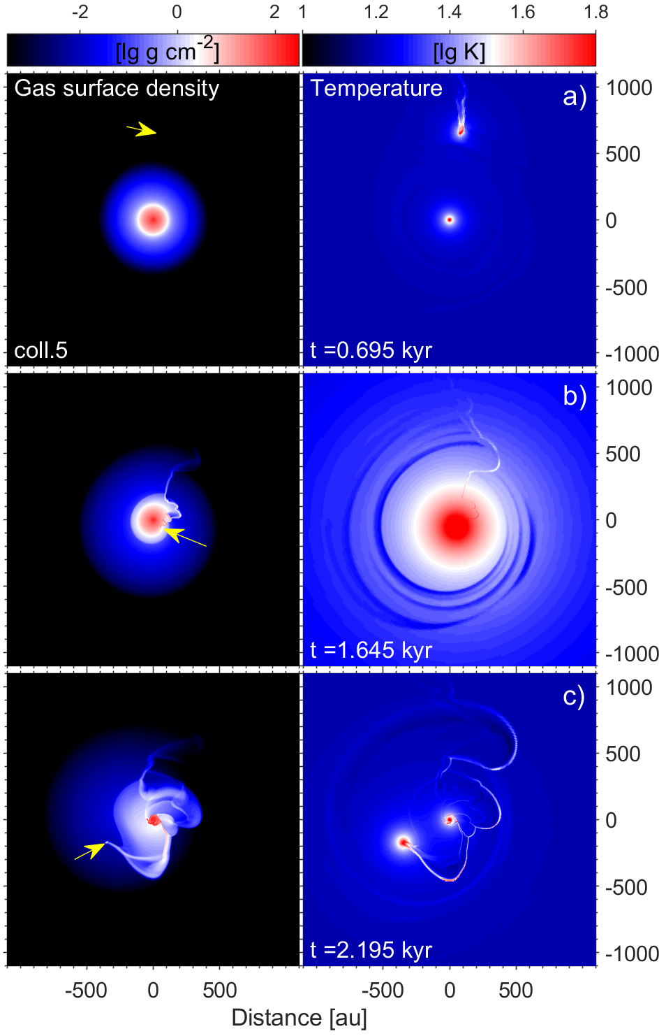
Periastron distance = 82.4 au
Intruder velocity = 5.21 km s⁻¹
Bursts triggered by collisions
Periastron distance = 75.3 au
Intruder velocity = 5.43 km s⁻¹
The intruder outshines the target
The intruder creates
tail-like structures
(Aikawa et al. 2019;
Vorobyov et al. 2020)

Slide 12
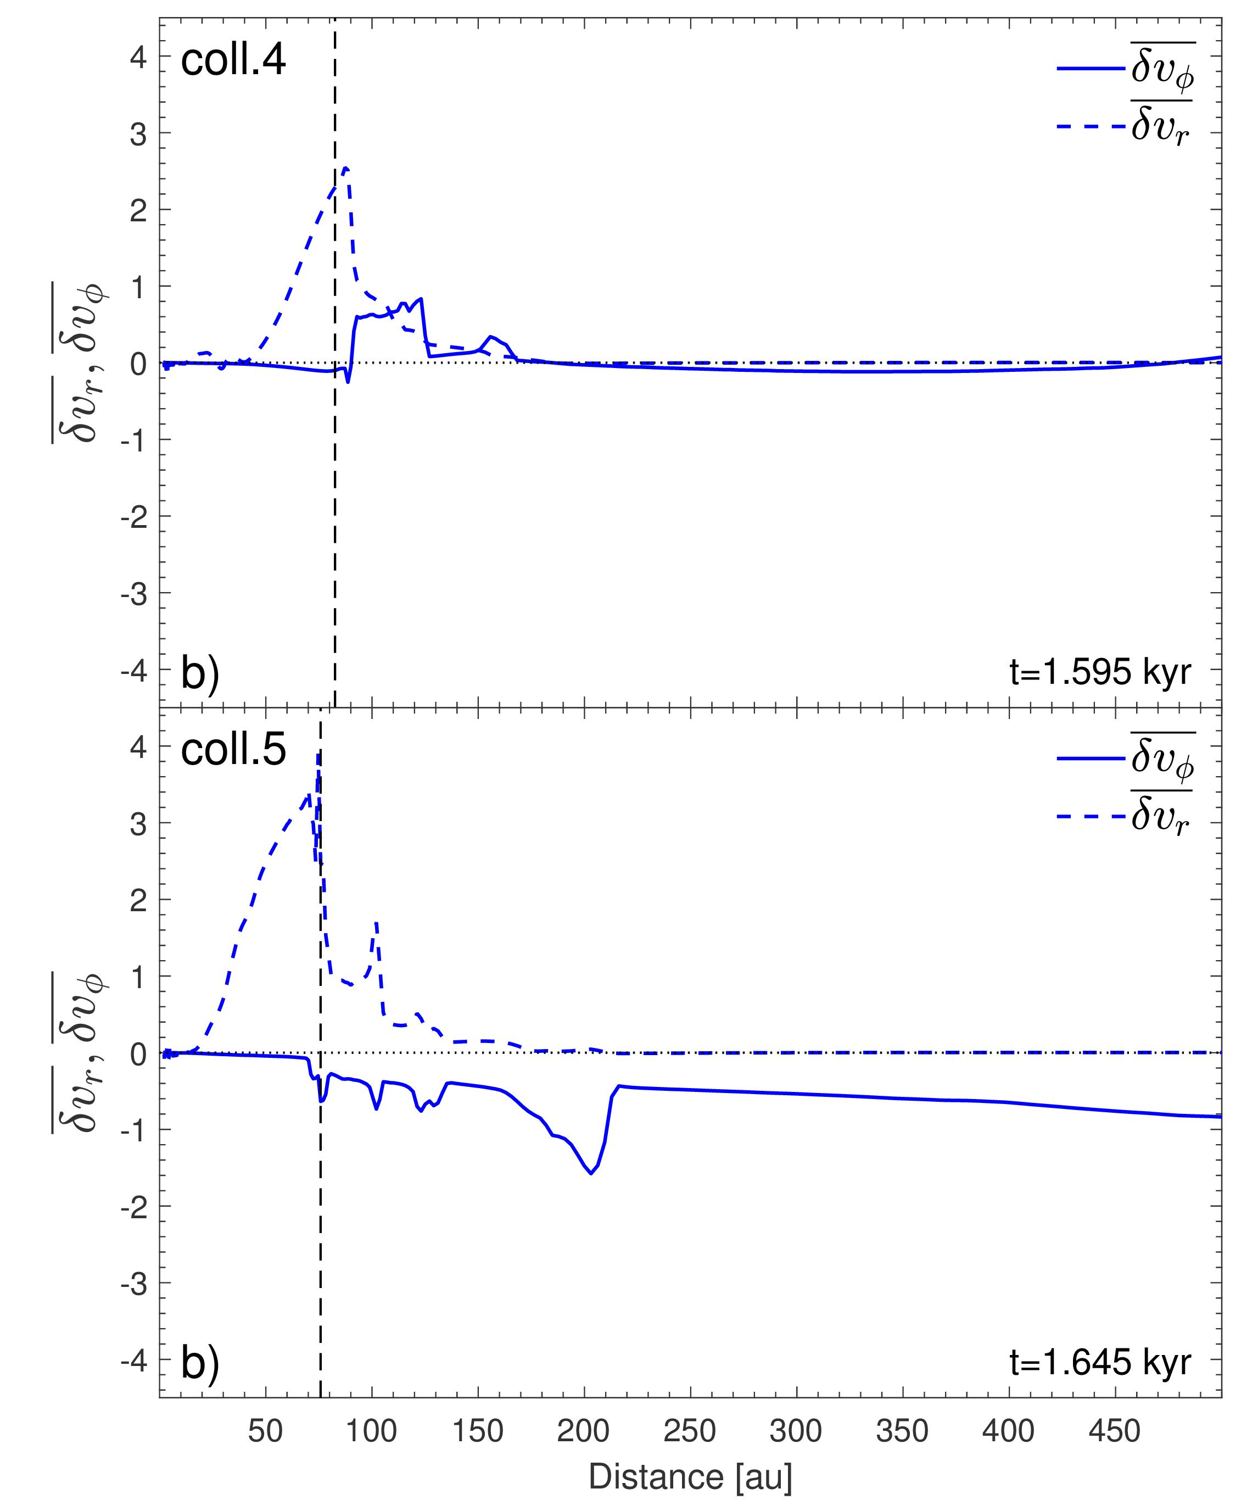
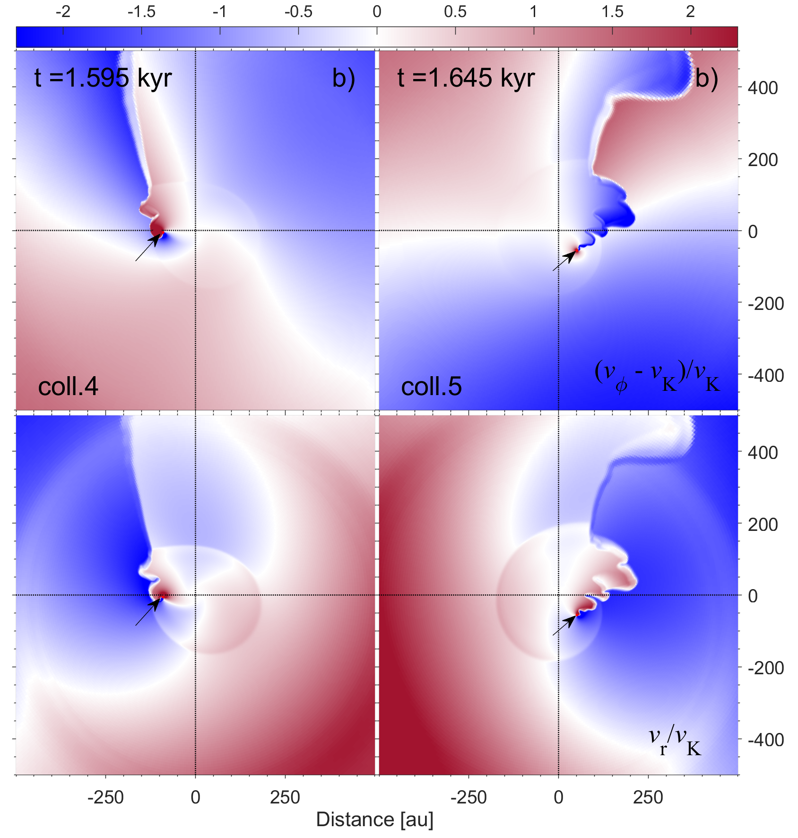
Bursts triggered by collisions
δv_{φ} = (v_{φ} – v_{K}) / v_{K}
δv_{r} = v_{r} / v_{K}
The strongest dynamical perturbation
(in the target disk)

Slide 13
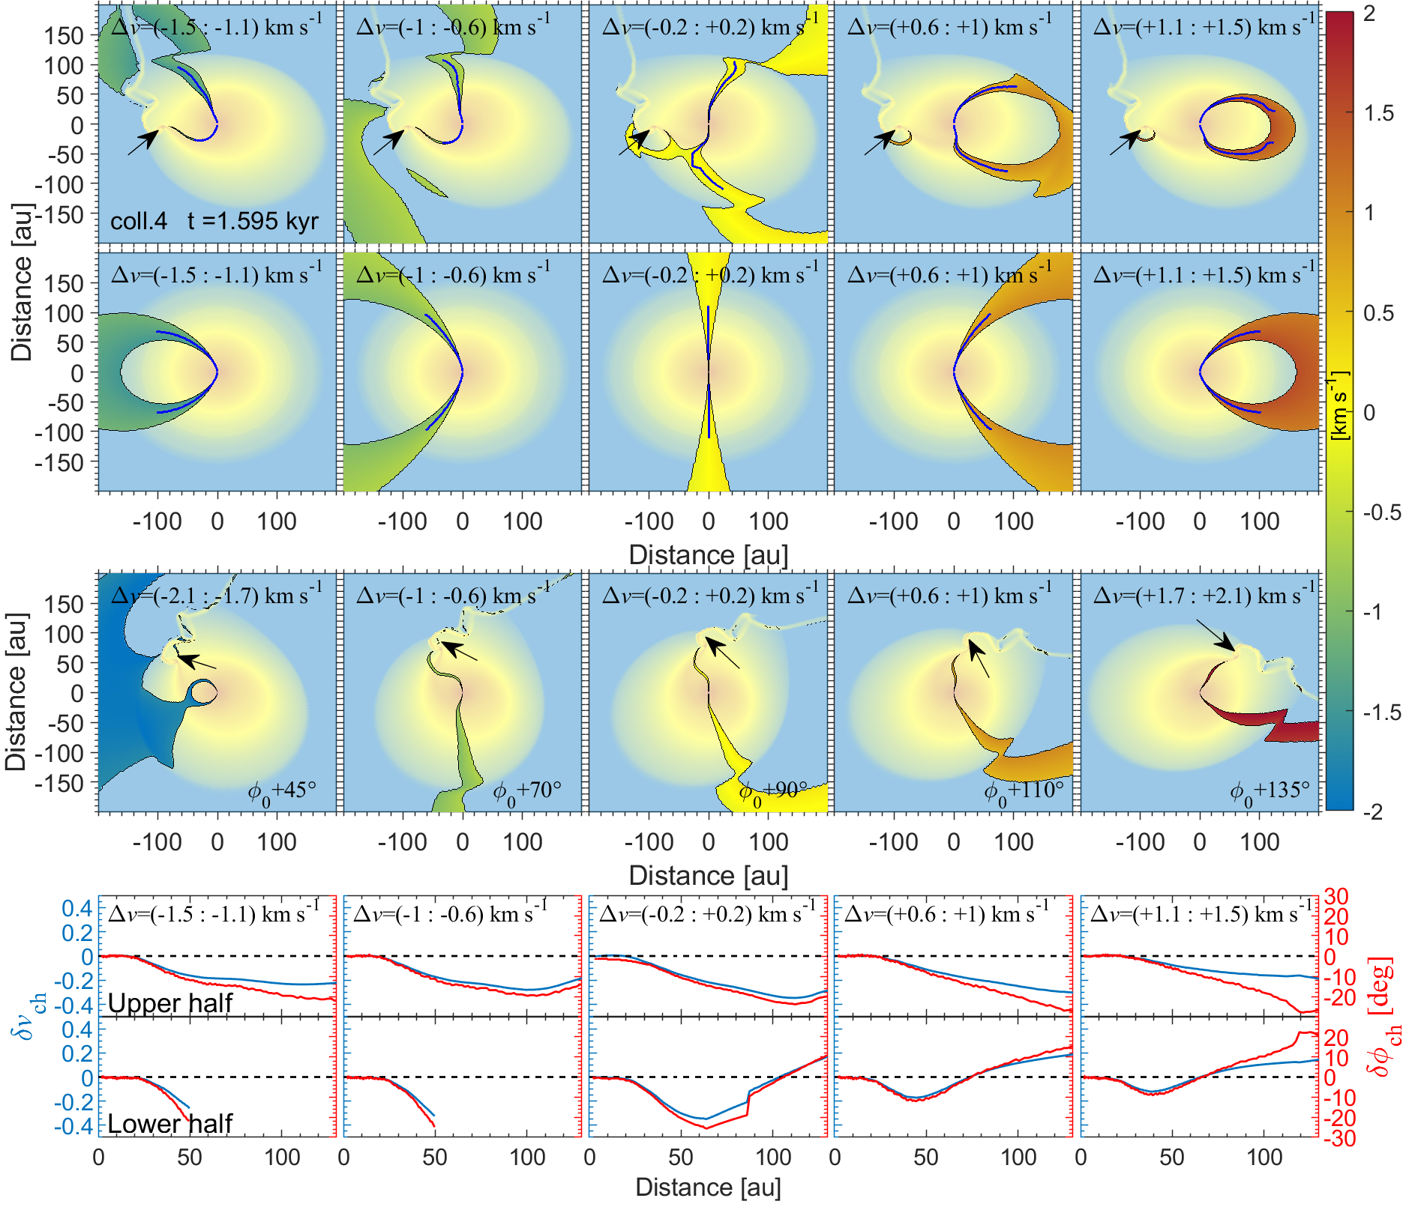
Bursts triggered by collisions

Slide 14
Conclusions
Peculiar kinematic features in the disk may help to distinguish between different burst origins.
For the MRI bursts, the velocities are characterized by kinks and wiggles that are typical for gravitationally unstable disks.
For the clump-infall models, the kinks are stronger and are even discontinuous at the edges of expanding spiral arcs created by in-spiraling clumps.
For the collision models, the kinks are strongest and discontinuous near the edges of the target disk.
The deviations of the model velocity channels from a symmetric pattern that is expected for a purely Keplerian disk may be helpful when distinguishing between the burst mechanisms.
This research was supported by the Russian Foundation for Basic Research, Russian-Taiwanese project 19-52-52011

